Slide 1
Unit - 2
Spreadsheet functions to organize data Part-2

Slide 2
lookup and reference functions
Sometimes we need to identify and search for a particular value in our dataset. This is when lookup and reference functions are helpful.
VLOOKUP
This function returns a value based on reference information presented in a vertical layout.
In the example below, Columns A and B represent reference information.

Slide 3
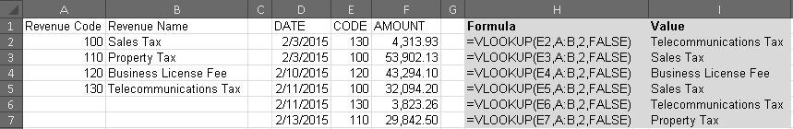

Slide 4
Columns D through F represent data we want to review.
In Column H, we are telling Excel to use the value in E2 to find the value for H2 by looking at the information in Columns A and B.
The first argument tooltip in our example is a “2.” This represents the Column B.
We have information on the revenue code (Column E) and want to return information on the revenue name (Column B).

Slide 5
In the next example, roll num, name and cgpa of a student is given. Here we are using Vlookup function to get cgpa of a student on entering the roll num of a student.
When we change roll num in the cell, cgpa automatically get changed.

Slide 6
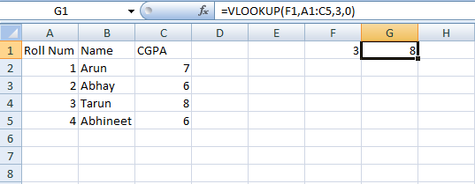

Slide 7
In the given example, we will find the percentage of a student using the given cgpa of student given in table 1.
Vlookup function is applied in B9.
Then multiplication formula in D9.

Slide 8
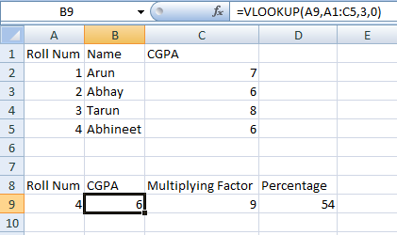

Slide 9
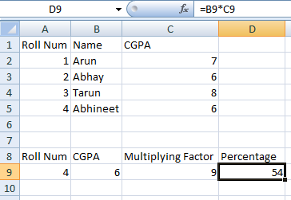

Slide 10
Instead of entering the values every-time, there is one option of using drop down list as well.
Go to Data Tab -> Data tools->Data Validation -> Allow -> List -> Source -> (Select the table) -> Enter -> Ok.

Slide 11
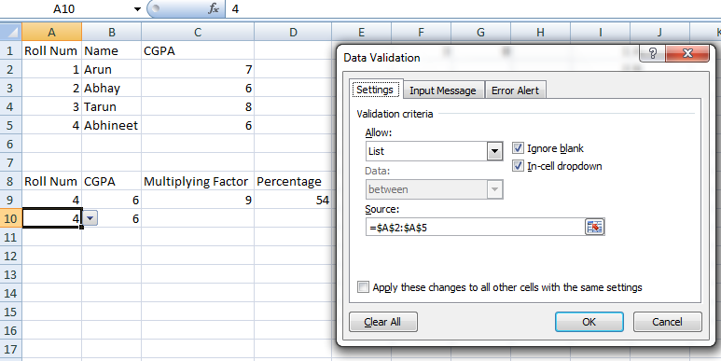

Slide 12
Vlookup using approximate match:
Less than 1st value in lookup column displays value as #NA.
Lookup value column should be sorted in ascending order.
Leaving 4th argument blank makes it as approximate match.
In the given example, let’s suppose we have to find commission given on the basis of sales

Slide 13
done.
If sales are exact matches then the 4th parameter of the vlookup function will be 0.
But practically sales are not fixed.
So in such type of cases, we can use vlookup with approximate match by setting up 4th parameter as 1.

Slide 14
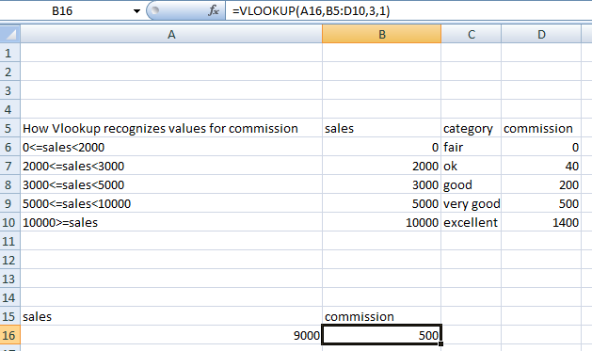

Slide 15
HLOOKUP
This is used to find the value in the horizontal table.
In the given example, price of products is given. Suppose we have to find the price of the products using hlookup function.

Slide 16
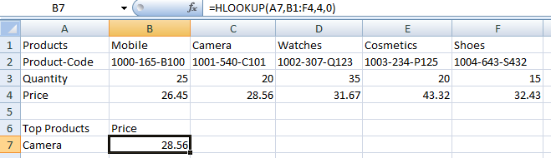

Slide 17
Vlookup Rules:
Lookup value should be unique in the column.
You can find values from left to right.
Lookup value should belong to the first column of the table array.

Slide 18
LOOKUP
Lookup function works for both vertical as well as horizontal table.
Instead of passing 4 different parameters, it takes two parameters for horizontal and vertical table.
In the given table, let’s find the tax wrt income using lookup function for both horizontal and vertical tables.
Select the table upto the resultant column

Slide 19
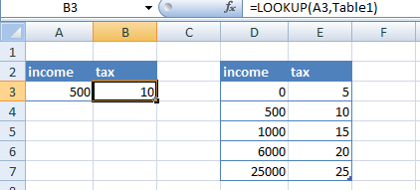

Slide 20
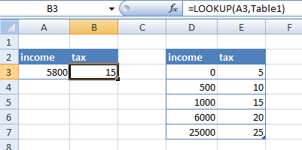

Slide 21
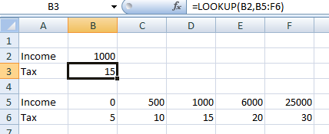

Slide 22
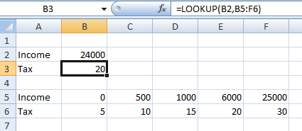

Slide 23
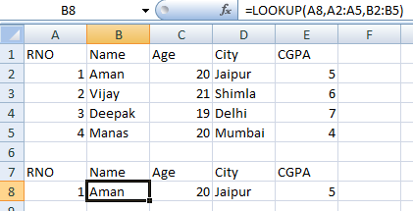

Slide 24
Lookup full record
To find the full record, there is an alternative known as match function.
In match function we need to write the cell address of the column name for which we want to extract the value, then the address of the column names from where we want to extract and then matching value.

Slide 25
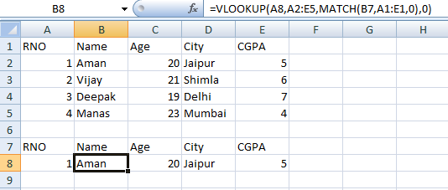

Slide 26
Index
Index function is used to find the position of an element in the table.
Index function takes first parameter as the value for which we want to find the position and second parameter as the serial number.

Slide 27
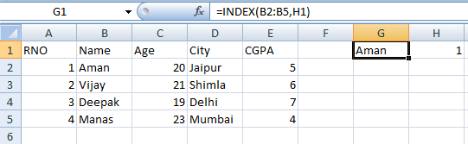
Index for 1D

Slide 28
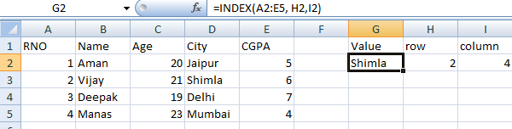
Index for 2D

Slide 29
Match
Match function is used to find the position of the any value in the array.
It takes three parameter such as lookup value, array from where we want to find the value and matching value.

Slide 30
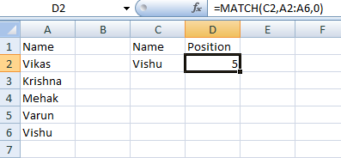

Slide 31
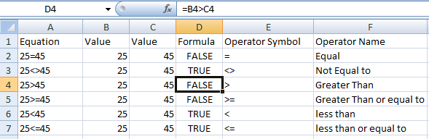
Logical Functions

Slide 32
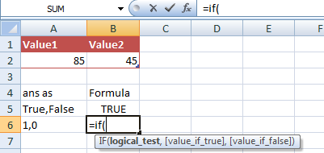
IF Function

Slide 33
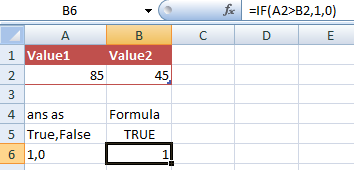

Slide 34
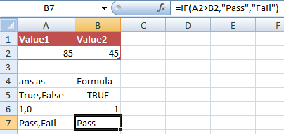

Slide 35
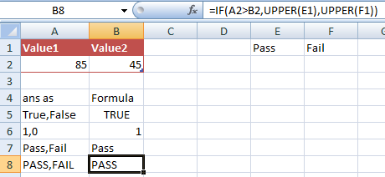

Slide 36
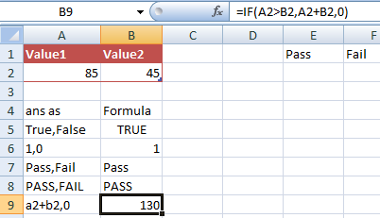

Slide 37
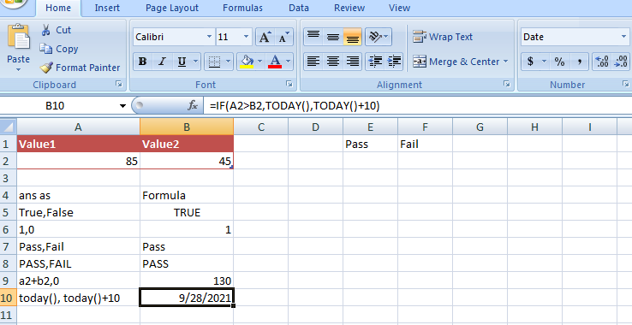

Slide 38
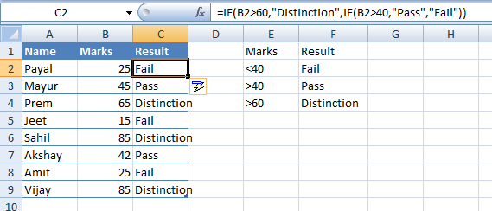
Nested If

Slide 39
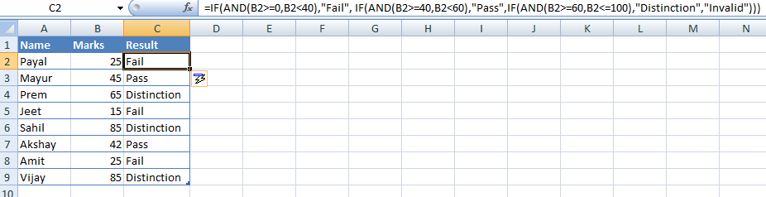
AND

Slide 40
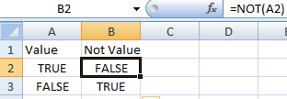
NOT

